Slide 1
How we can help

Slide 2




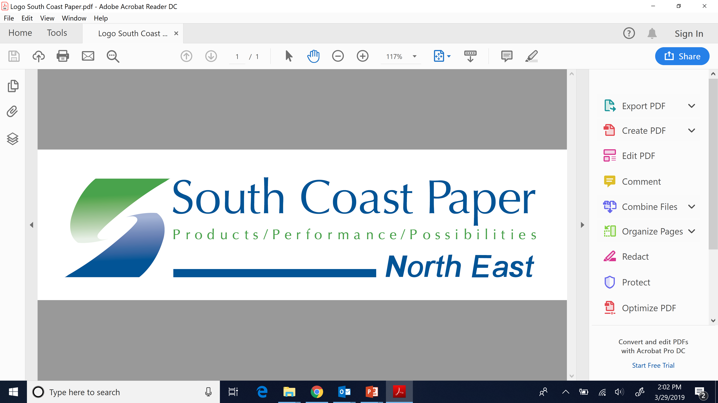
Columbia, SC
Tultitlan Estado de Mexico
Maplesville, AL
Florence, NJ

Slide 3
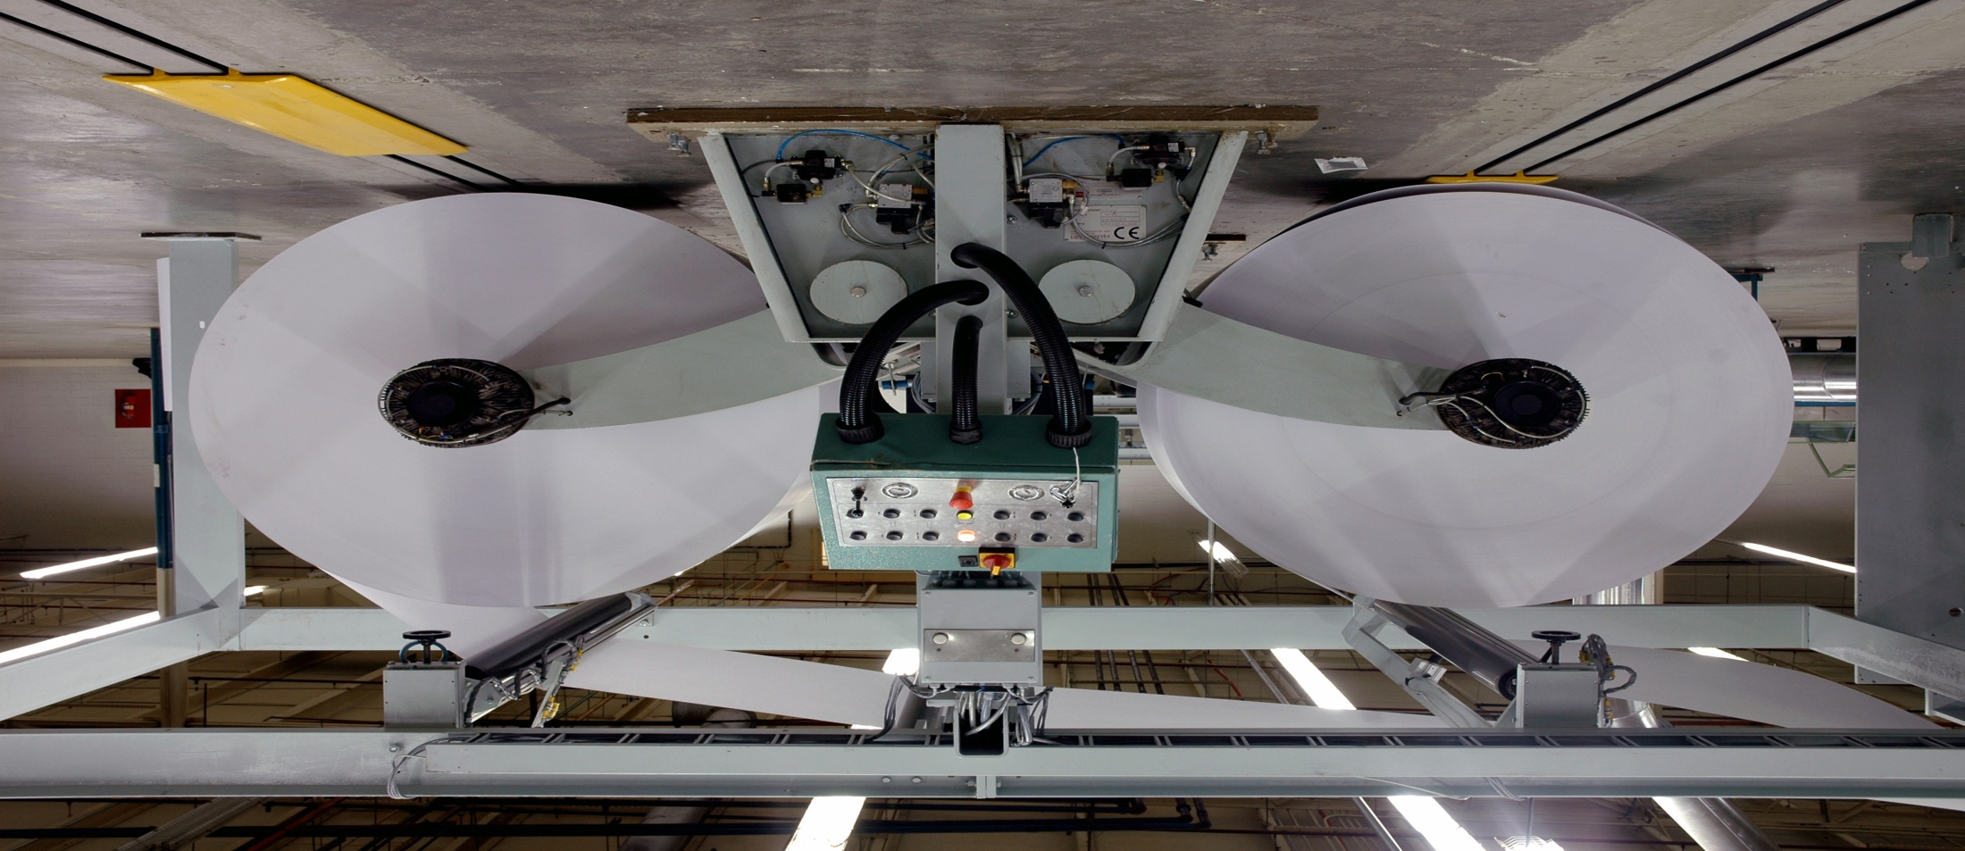
Paper
Converting

Slide 4
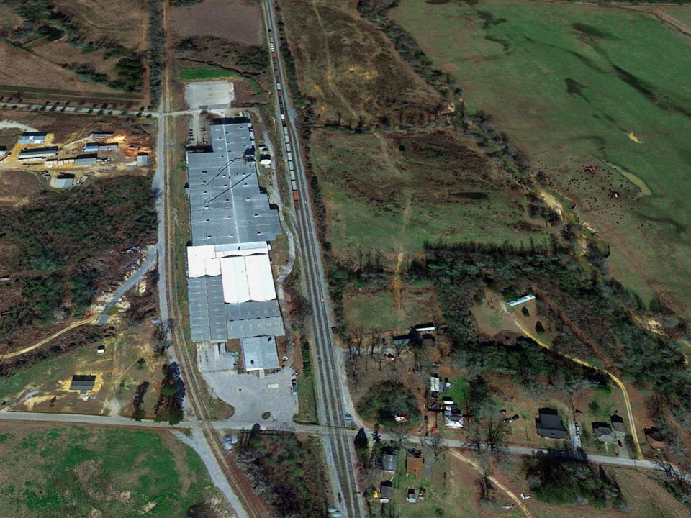

Our 225,000 sq ft production facility is located in Maplesville, Alabama
60,000 sq ft
high bay
roll storage
2 truck high docks
4 rail access car spots
PRODUCTION FACILITY
90,000 sq ft
conditioned finishing area
70,000 sq. ft.
finished goods
4 truck high docks

Slide 5

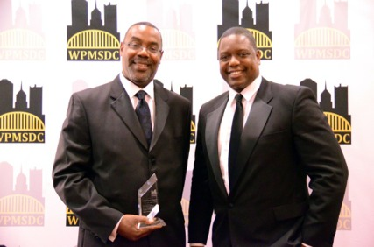
Sales &
Marketing

Slide 6

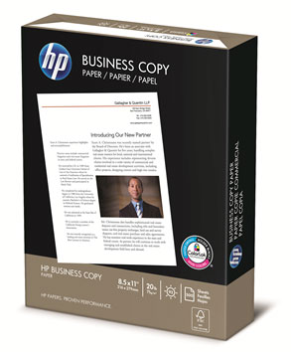
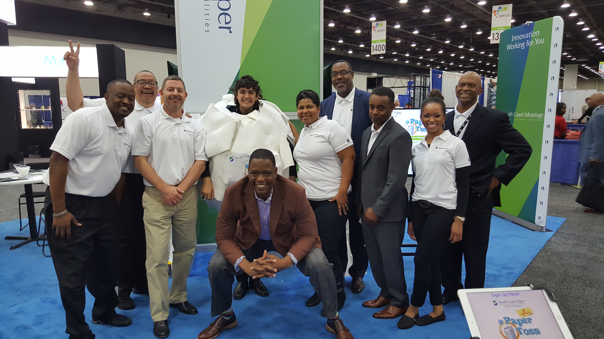



Our sales and marketing team helps our clients market and distribute private label and nationally branded
products.

Slide 7
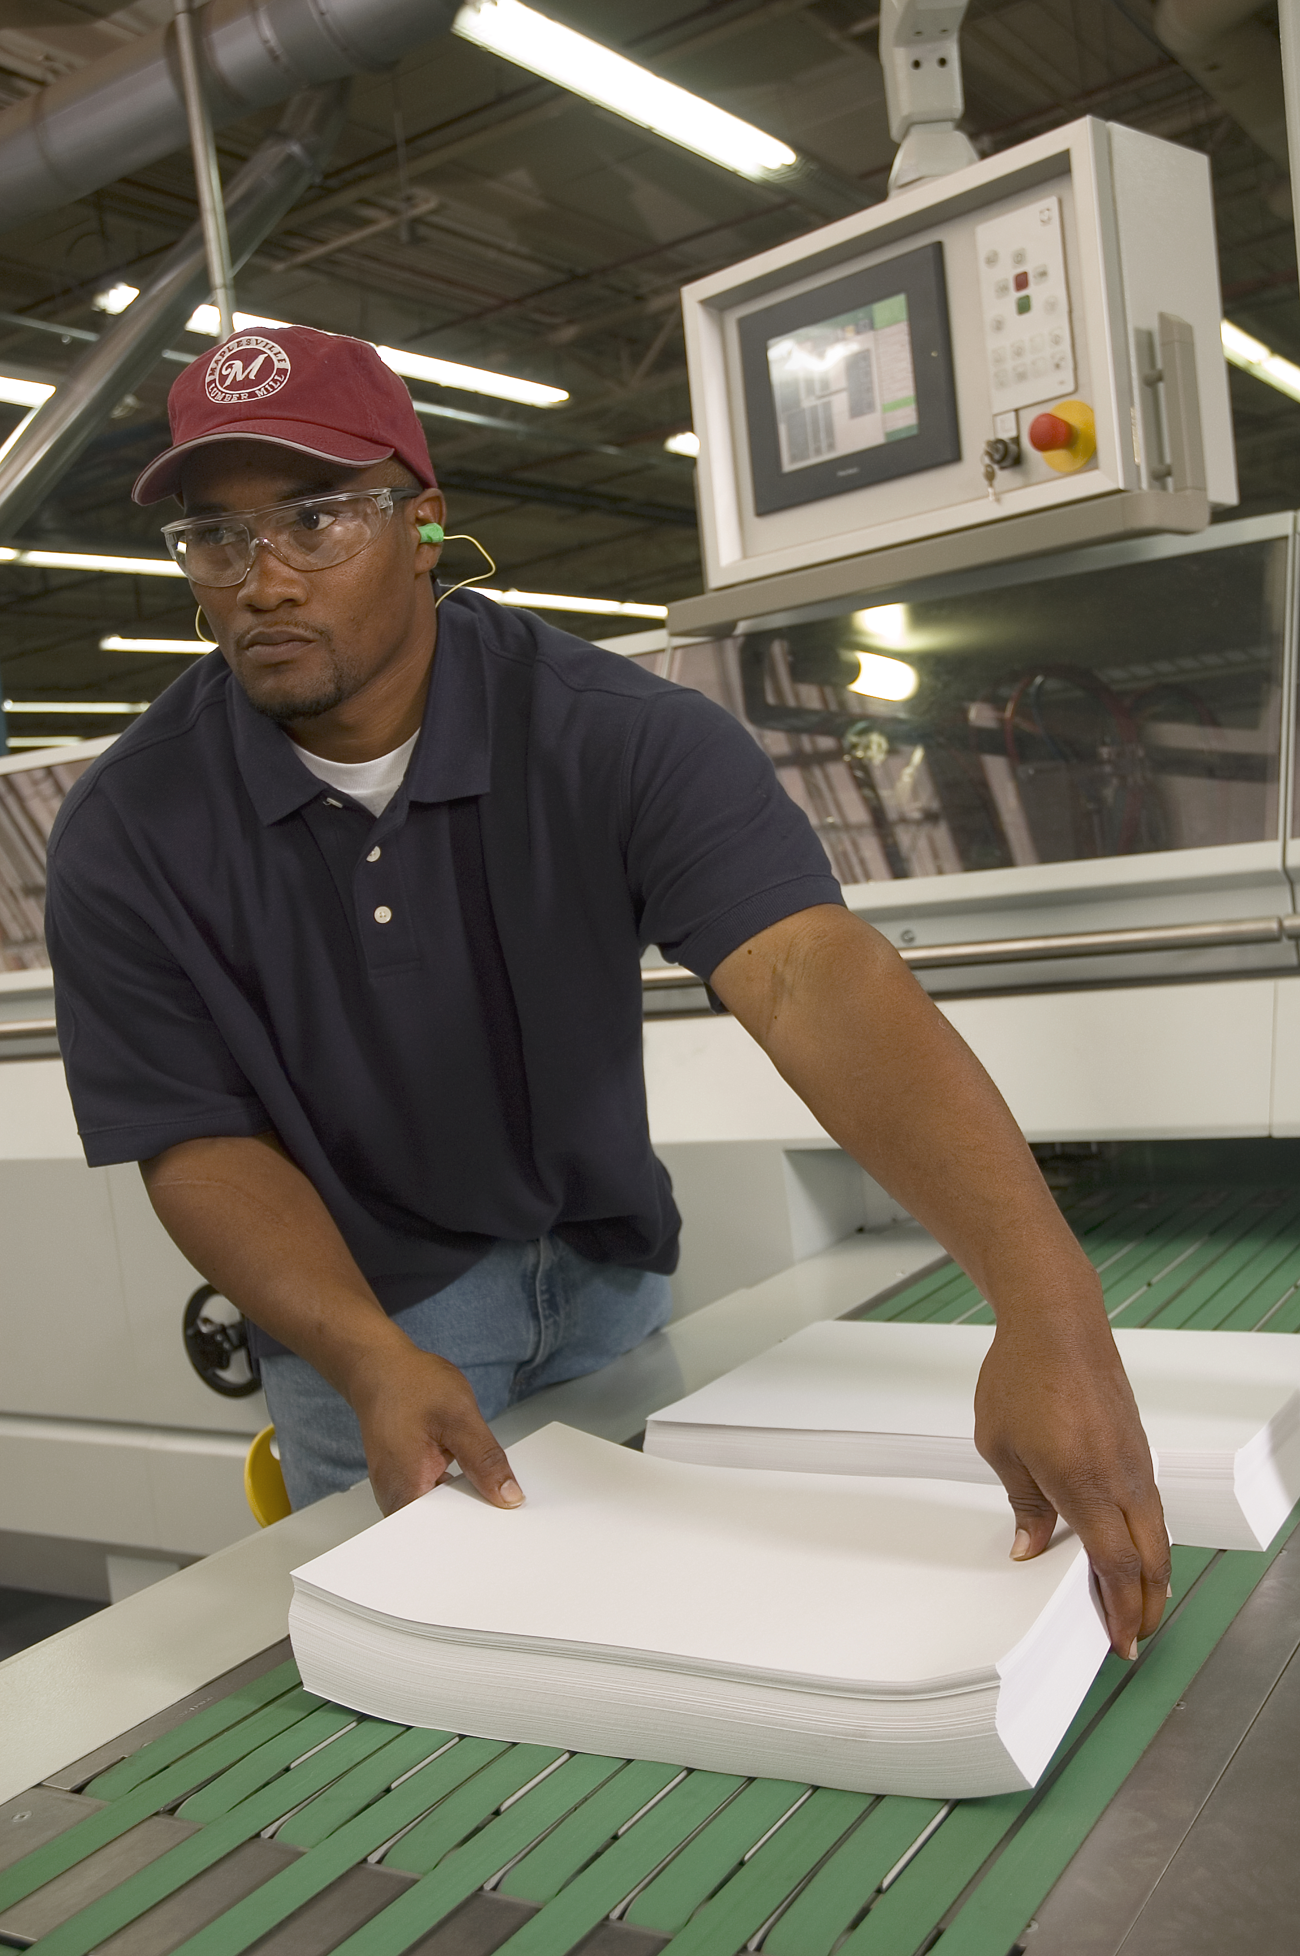
South Coast Sales Products Pre-Covid
Engineering Bond/Wide Format
Corrugated Packaging
Dye Sublimation Paper
Business Papers

Slide 8
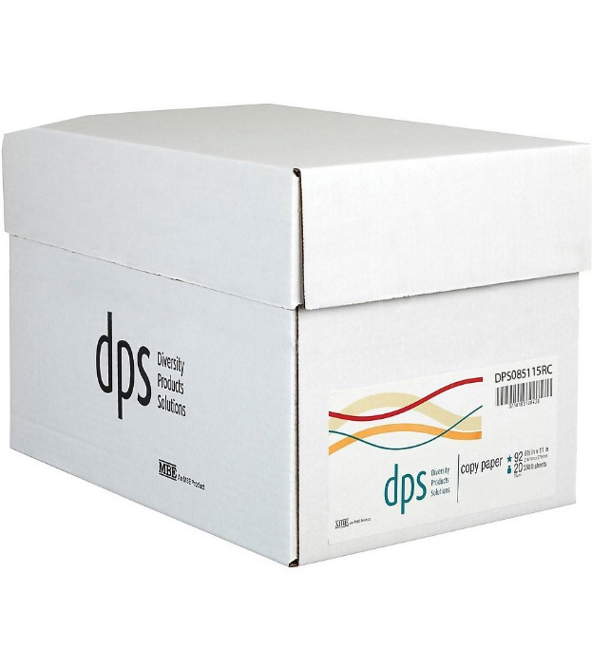
South Coast Plant Production Pre-Covid
Engineering Bond/Wide Format
Dye Sublimation
Business Papers
Folio Print Paper/Digital

Slide 9
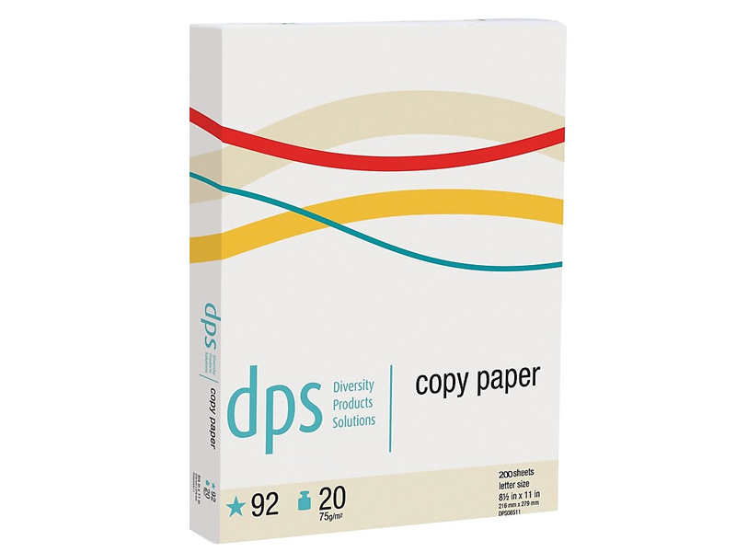
South Coast Plant Business Review April 2020
No orders and opportunities
April annualized orders down 50%
No playbook for a pandemic
Massive uncertainty on all areas
Critical Business Decisions Made

Slide 10
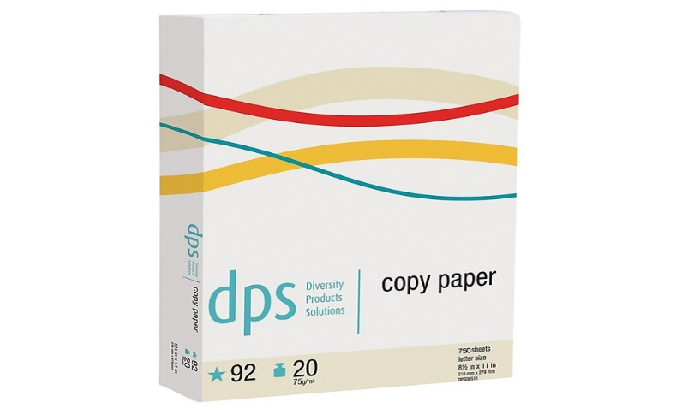
South Coast 2020 Analysis Areas
Financial Plan to Survive
Plant Production and Operation
Product and Sales Growth
Customers/Relationships

Slide 11
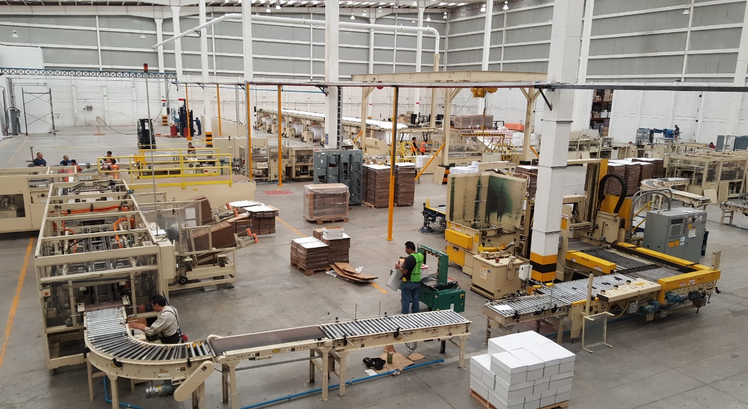
South Coast Decisions 2020
Financial and Accounting Priority – Took advantage of all Federal and State incentives
Production realignment – protocol and process, products, plants sites
Product Sales Portfolio – what products we were selling
Customer Evaluation/Relationships
Supplier Evaluation/Relationships
Technology upgrades
Salaries and Personnel

Slide 12
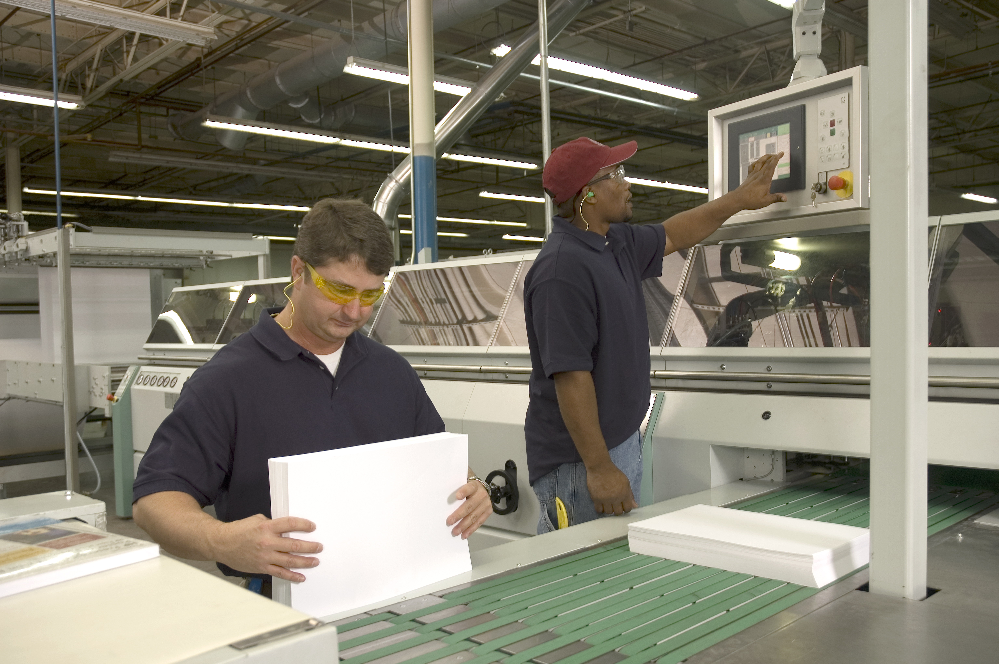
South Coast Plant Production Post-Covid
Dental Tray Paper
Business Papers Small Pack
Folio Print Paper/Digital

Slide 13
South Coast Sales Products Post-Covid
Engineering Bond/Wide Format
Corrugated Packaging
Digital packaging
Dye Sublimation Paper
Business Papers/Small Pack
Notetaking products
Indoor signage

Slide 14
South Coast Pivot Points
Financial Fitness
Manage Relationships
Product Evaluation
Ask for Something

Slide 15

Todd Keller
National Sales Manager
t.keller@southcoastpaper.com
504-975-6995
Kenny Loyd
President
k.loyd@southcoastpaper.com
225-773-9883

